Slide 1
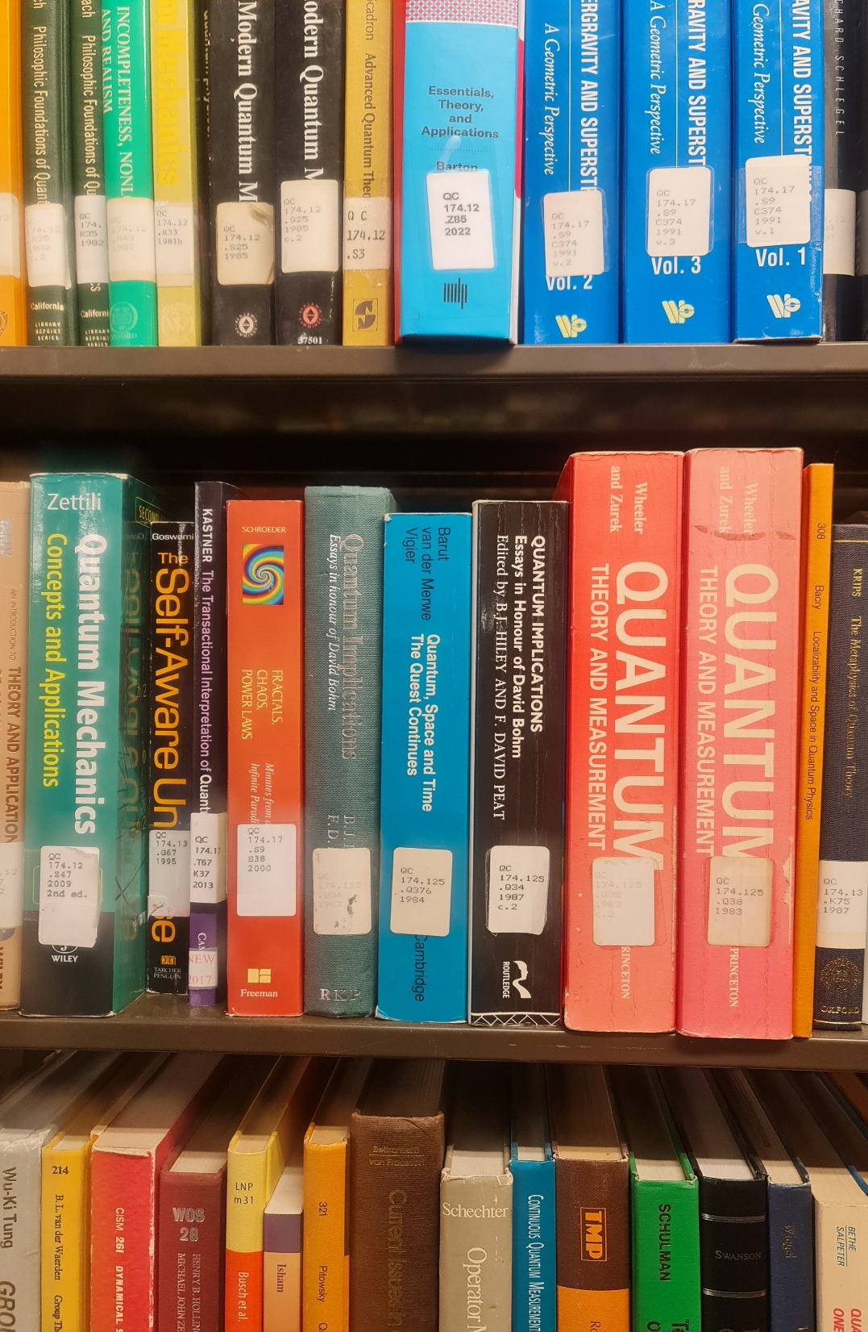
Library Management System v1.0.0
Team members:
Group 2
Hillary Arinda
Tonny Kakooza
Geoffrey Duncan Opiyo

Slide 2
STEPS WE TOOK
Software Development Life Cycle
Requirement Analysis
Static model
Dynamic model
Design, coding and testing

Slide 3
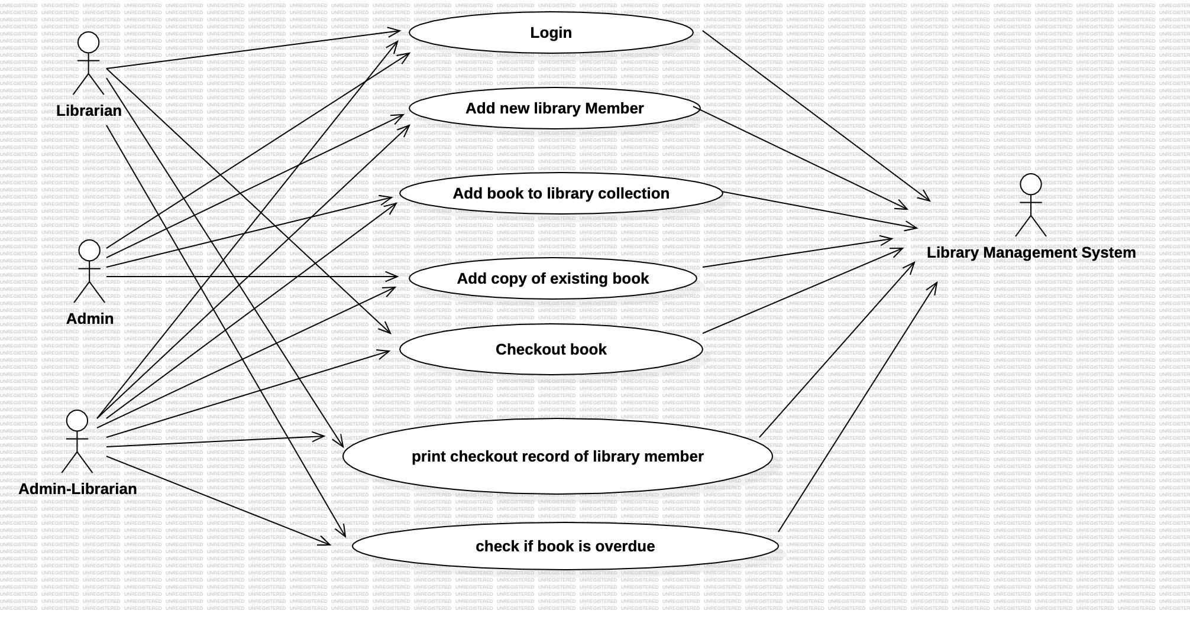

Slide 4
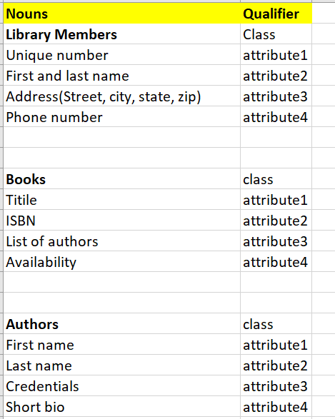
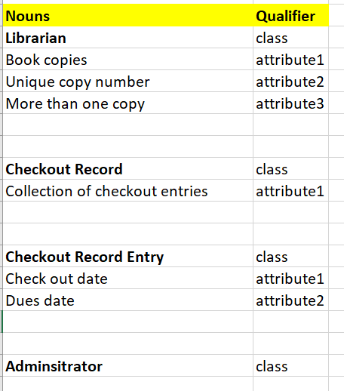

Slide 5
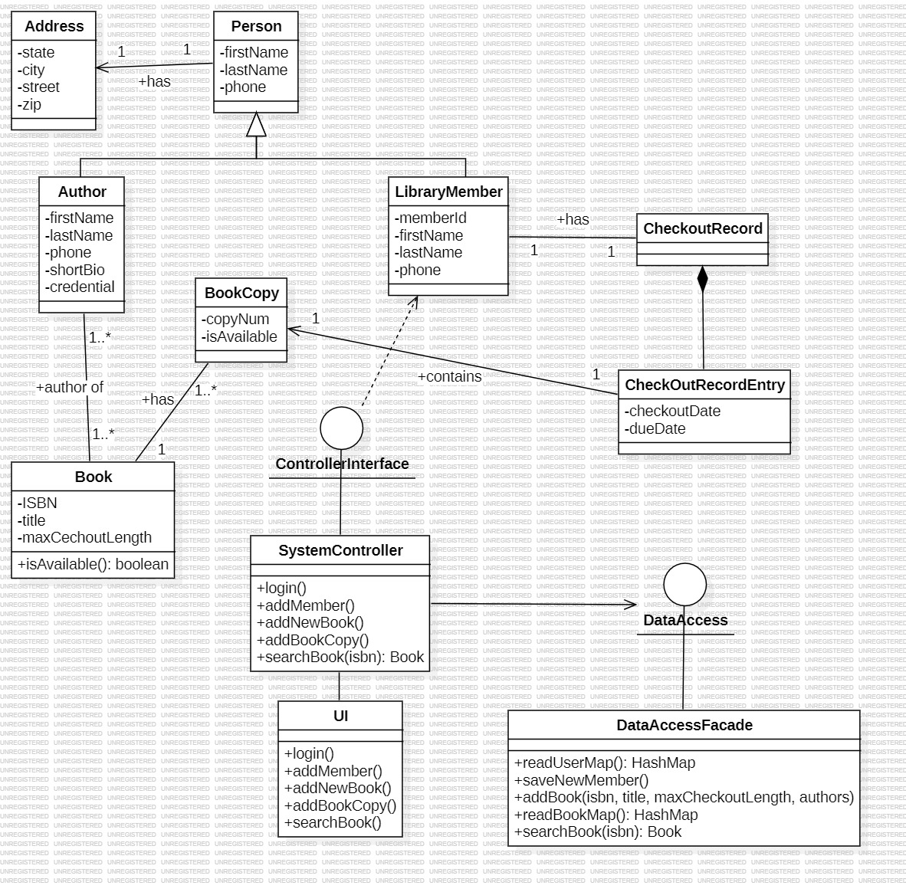

Slide 6
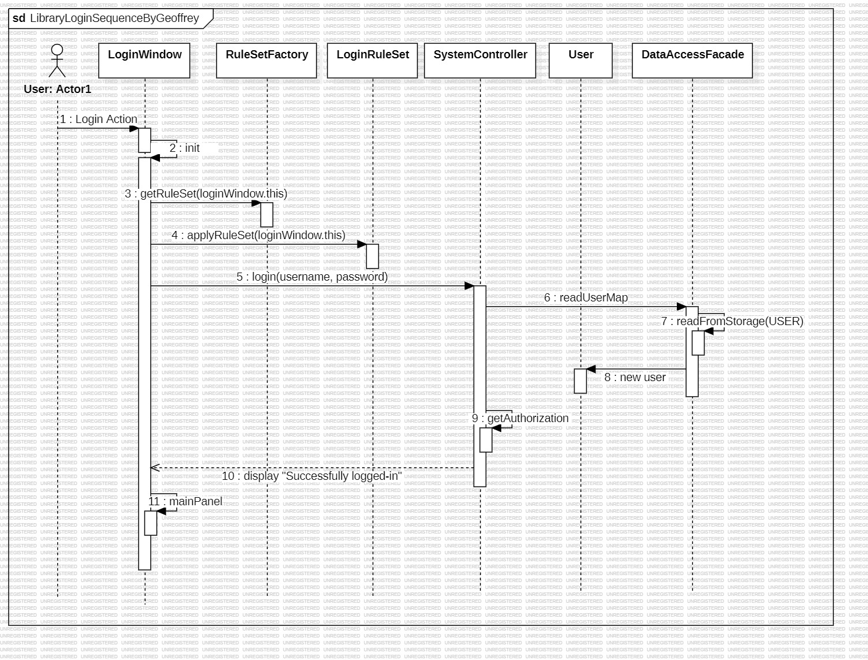

Slide 7
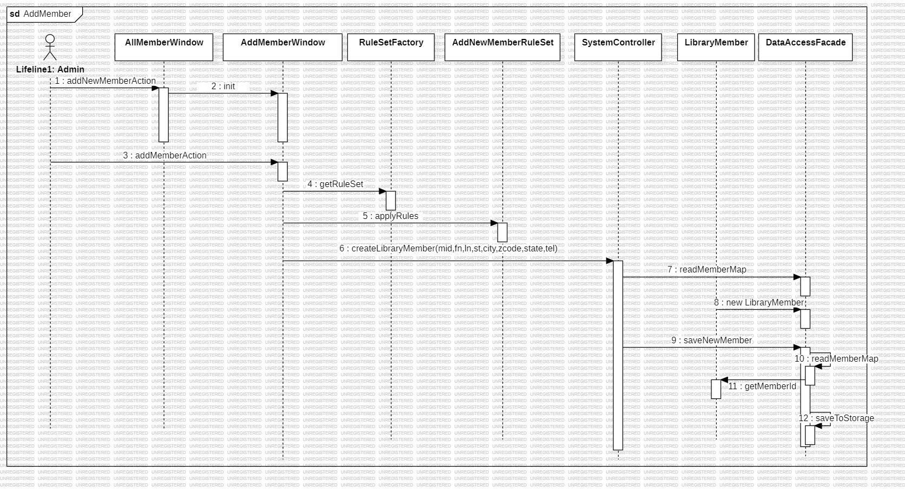

Slide 8
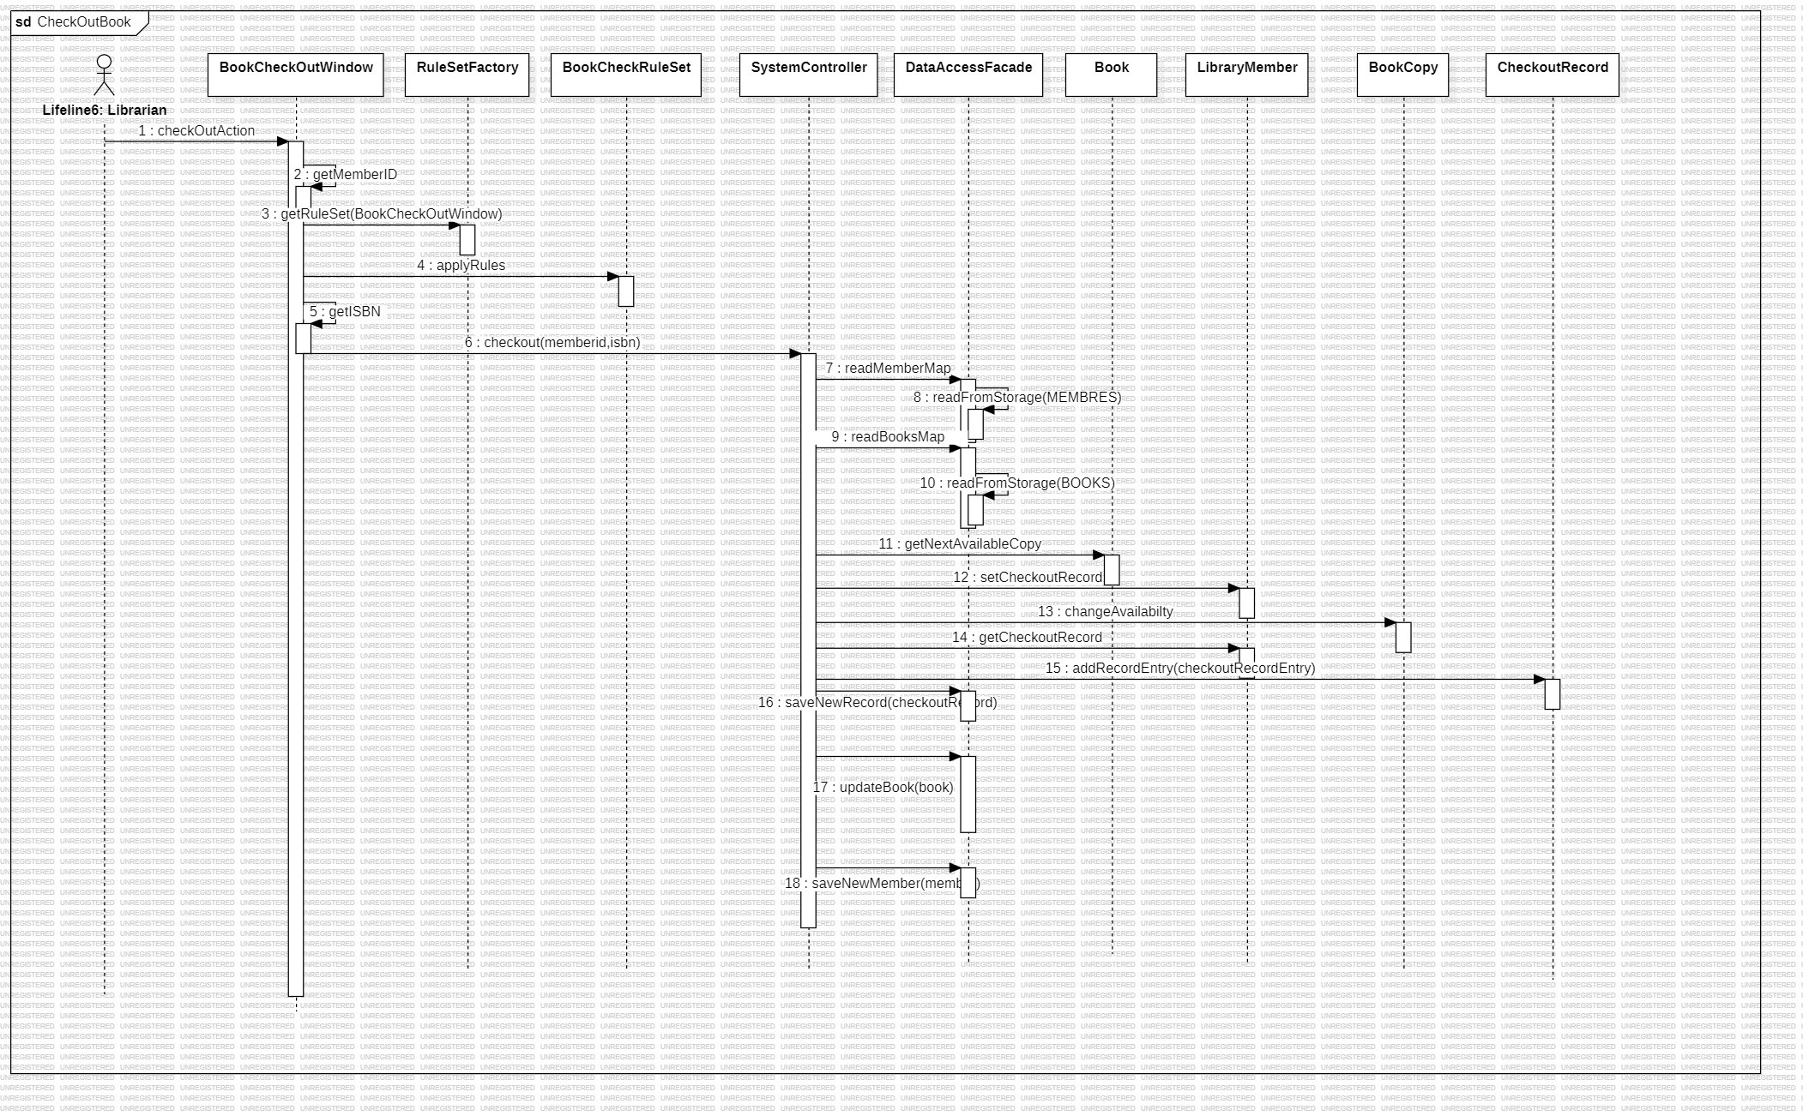

Slide 9
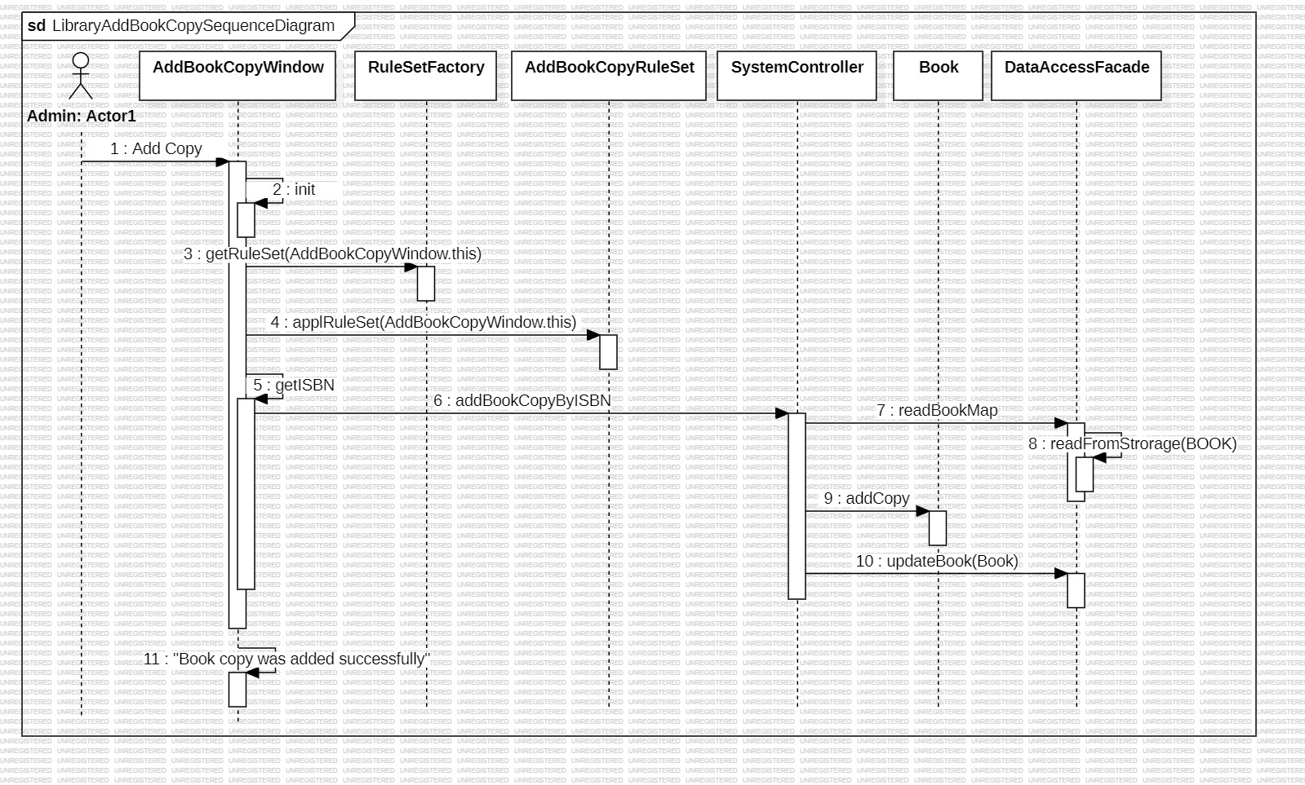

Slide 10
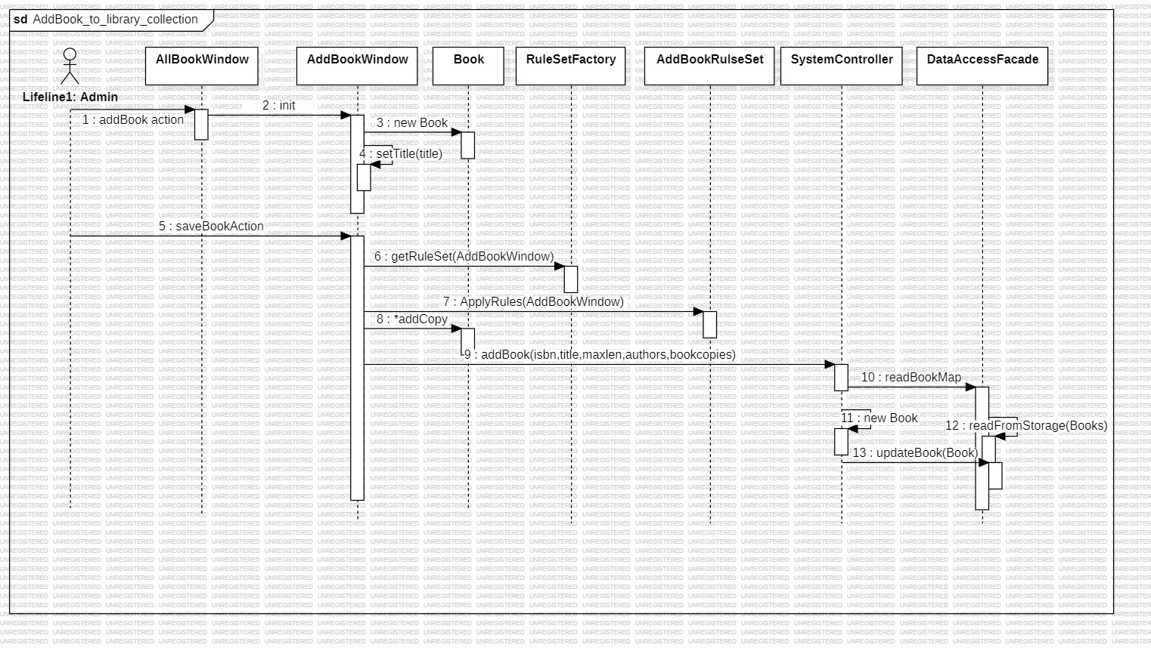

Slide 11
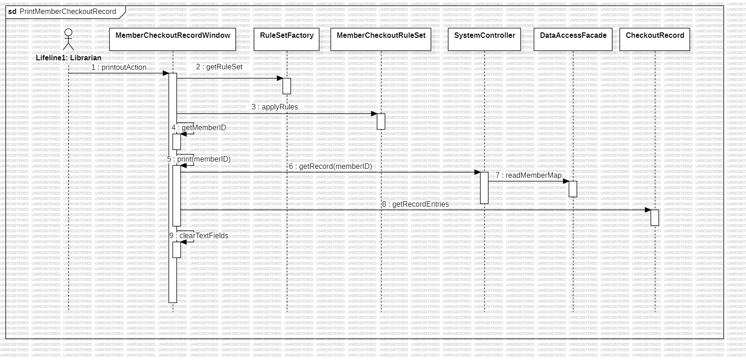

Slide 12
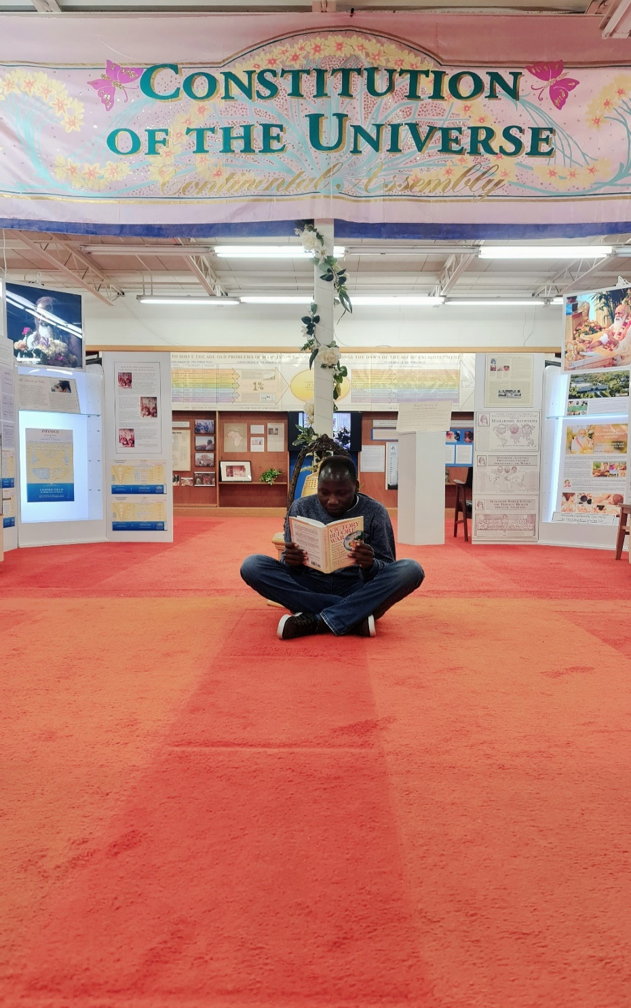
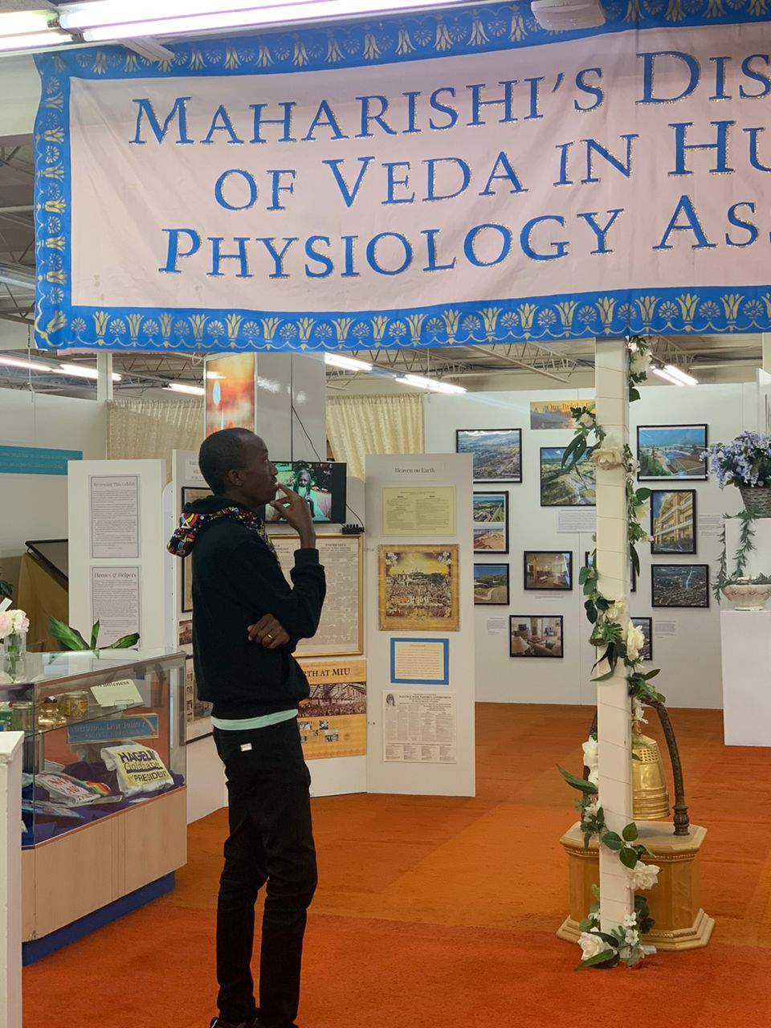
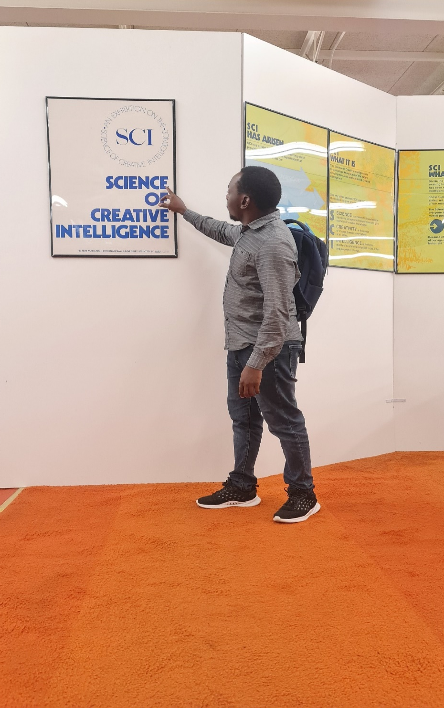
“I hold that life is bliss. In essence, life is not a struggle” – Maharishi Mahesh Yogi

Slide 13

Practice TM
Group 2 – with LOVE
Wisdom
Creativity
Unbounded Awareness

